Slide 1


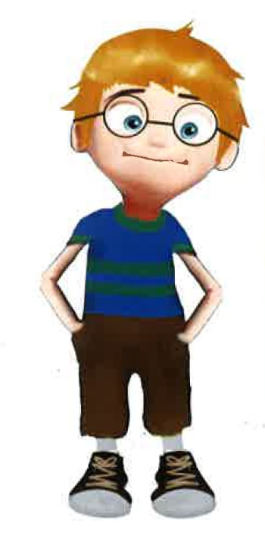
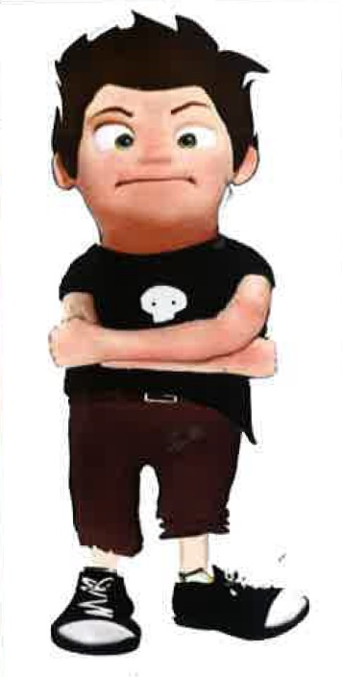
Pablo Fernández Pena
Audiovisual technician - CUFIE
PTXAS UDC
Manuel García Torre
PhD, Lecturer
Coordinator of the E-Learning Unit (CUFIE)
Department of Sociology and Communication Sciences
Faculty of Communication Sciences, University of A Coruña

Slide 2



How can we manage a film shooting?
Tips and advices to understand and organize it.
Notes:
Start with editing app. Present app. Edit three takes and create video.

Slide 3
Index
Shots
Camera Angles
Point of view
Continuity
180-degree rule
30-degree rule
Planning the shot

Slide 4
1. Shots
The part of the scene that we decide to show, therefore, is the part that the spectator will see.
Eye and cameras are apparently very similar but they have a fully different way of work.
Eye transmit information by continuous micro-movements to the brain. We only see in focus a very little spot.
Cameras captures everything in front of them.
BE CAREFUL and TAKE CARE of ALL of the elements.

Slide 5
Shots
Wide and closed

Slide 6

Wide shots
-To show where the action is (location shot).
-Very useful for showing large movements.
-To clarify the characters' positions.
-To create a certain atmosphere.

Slide 7
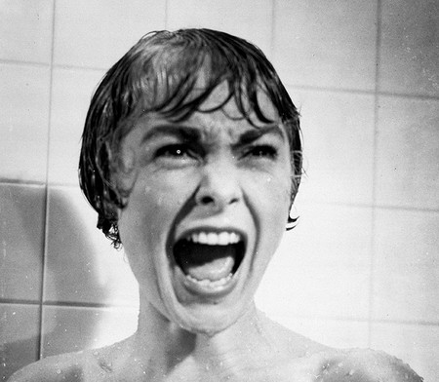
Closed shots
-To show details
-To create empathy
-To show the characters' reactions
-To heighten the drama

Slide 8
Shot scale
Human being as a reference
-Big long shot*
-Long shot*
-Full shot
-American/western shot
-Medium shot
-Close up
-Big close up
-Detail shot
*Opening/closing shots

Slide 9
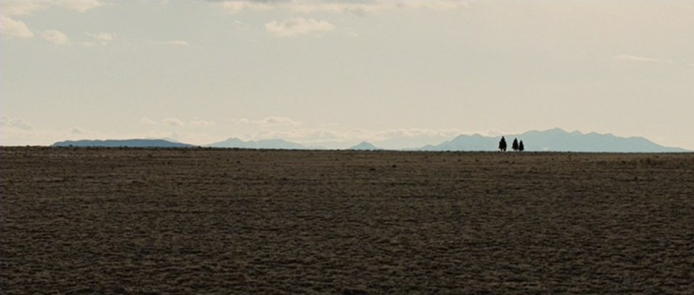
Shot scale
Big long shot
Human figure is a speck of dust

Slide 10
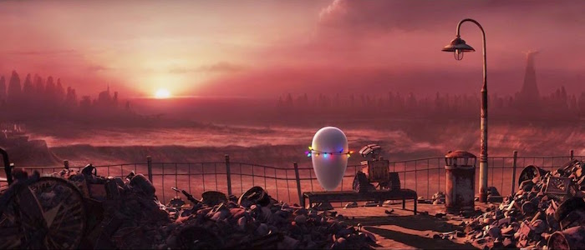
Shot scale
Big shot
Human figure is a small element, but recognizable

Slide 11
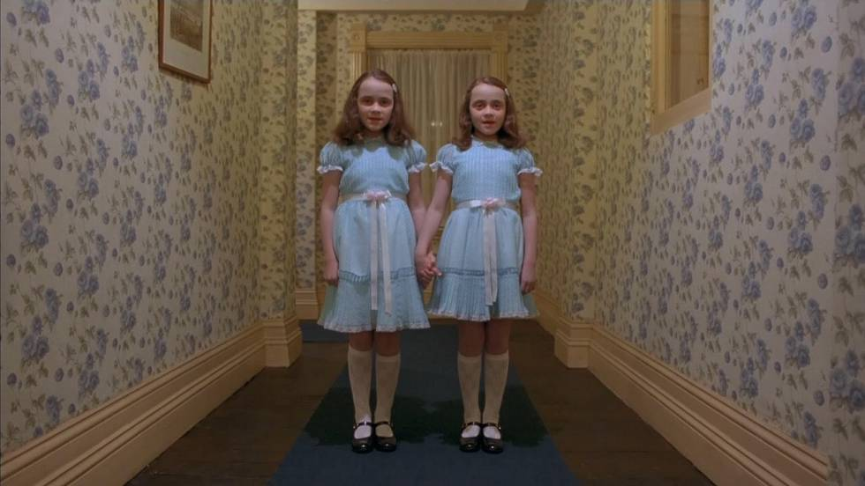
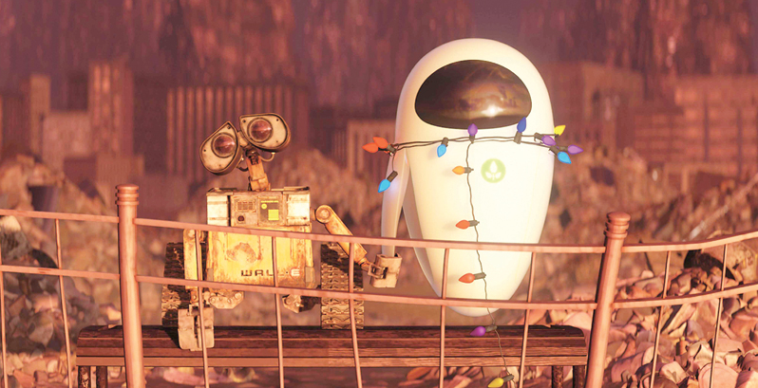
Shot scale
Full shot
Human figure is the main element

Slide 12
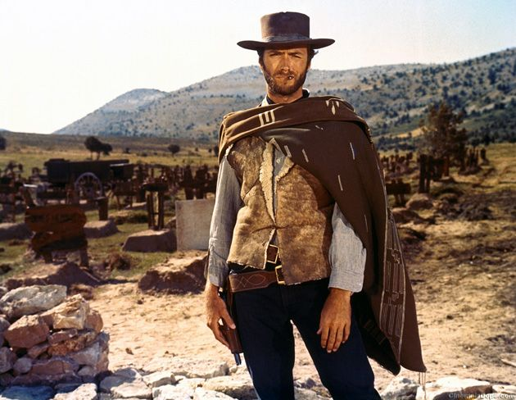
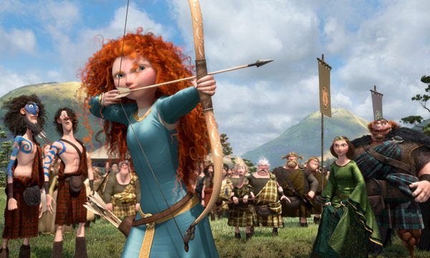
Shot scale
American/western shot
Human figure is cutted by the knees

Slide 13
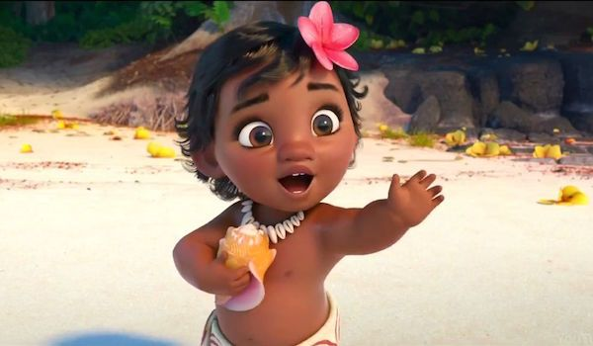
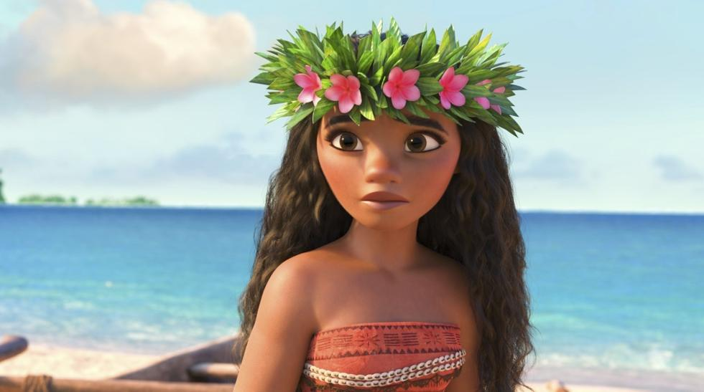
Shot scale
Medium shot
Medium – Medium wide – Medium close
Human figure is cuted by the waist or chest

Slide 14
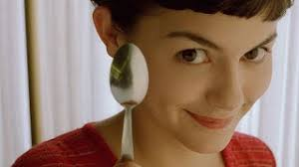
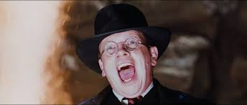
Shot scale
Close up
Head and face are the main elements

Slide 15
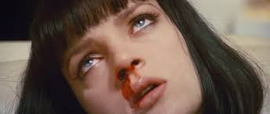
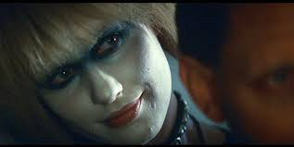
Shot scale
Big close up
Forehead and chin.

Slide 16
Shot scale
Detail shot
Small part of the face

Slide 17
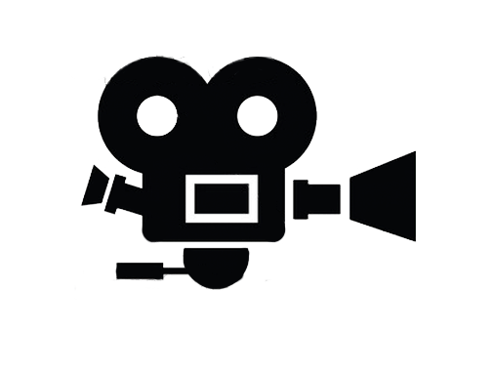
2. Camera angles
Over/levelled/under
1
1. Zenith (bird-eye)
2. High angle
3. Normal
4. Low angle
5. Nadir
2
3
4
5

Slide 18
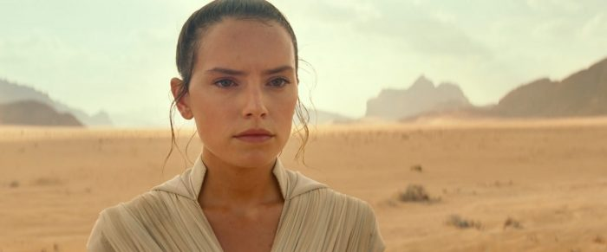
2. Camera angle
Normal
The most balanced angle.
The character and the viewer are in the same position.

Slide 19
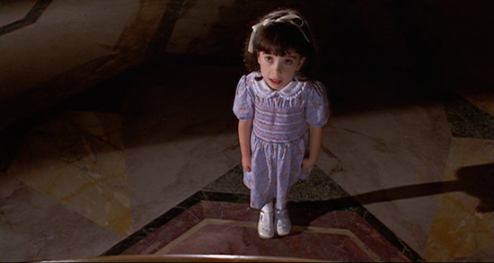
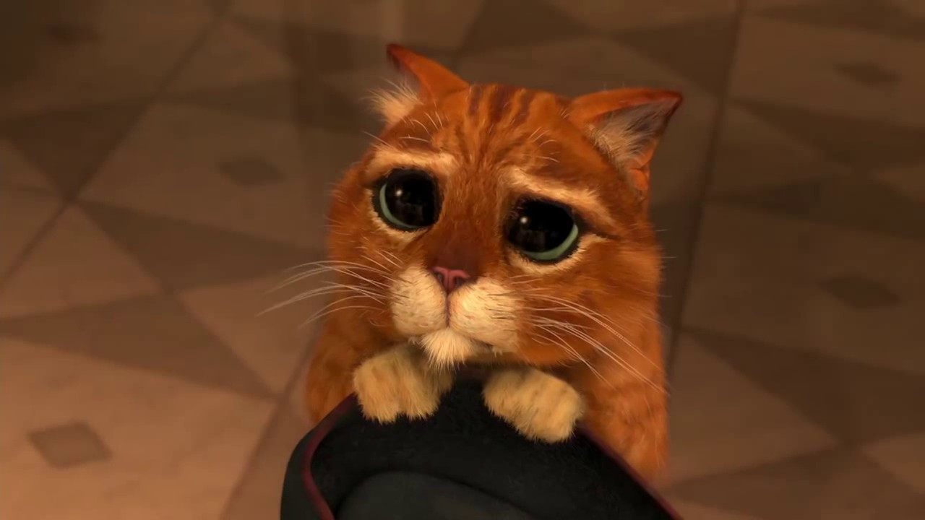
2. Camera angles
High angle
-Reduce characters.
-Very useful to show power/domination situations.

Slide 20
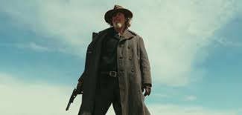
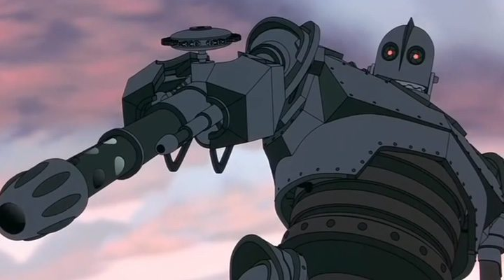
2. Camera angles
Low angle
The camera is under the character's eye line.
It increases the power and psychological strength of the character.

Slide 21
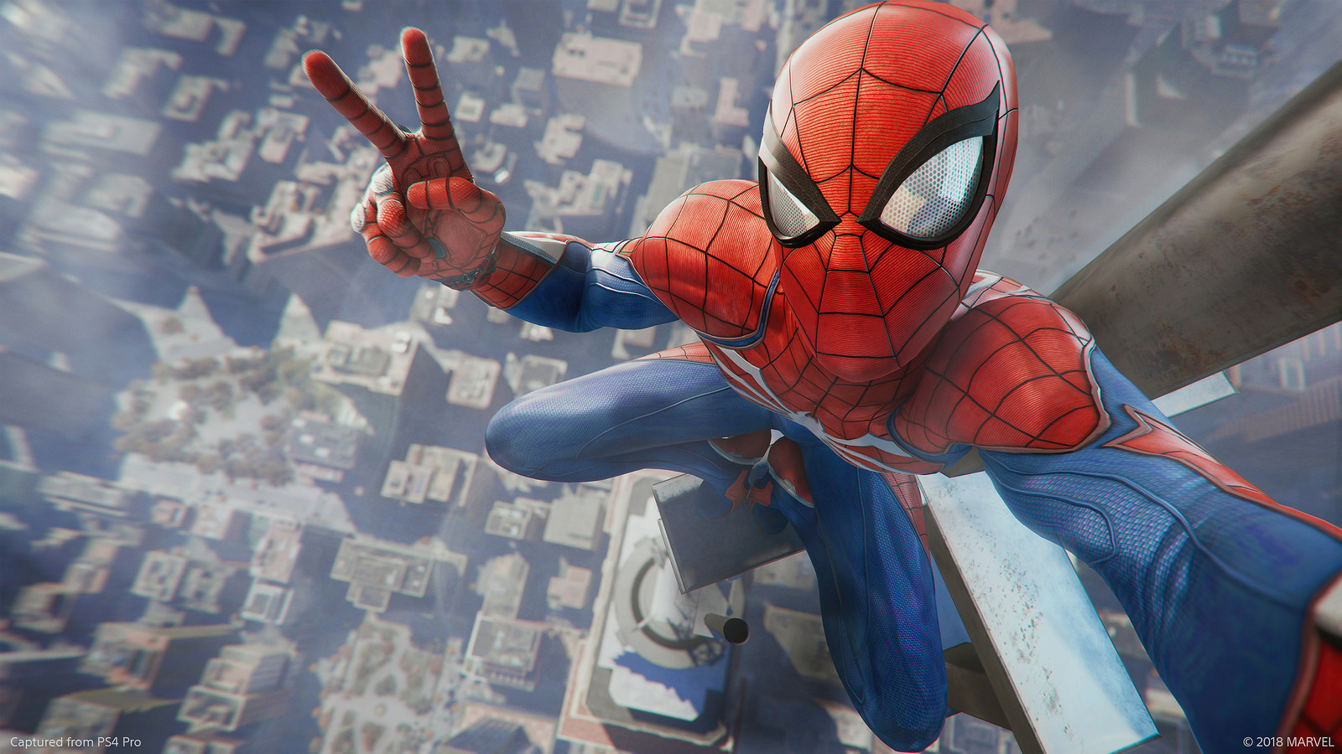
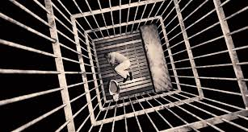
2. Camera angles
Zenithal
The camera is right above the action or the character.
They reinforce shapes and movements.
They are quite complicated to shoot.

Slide 22
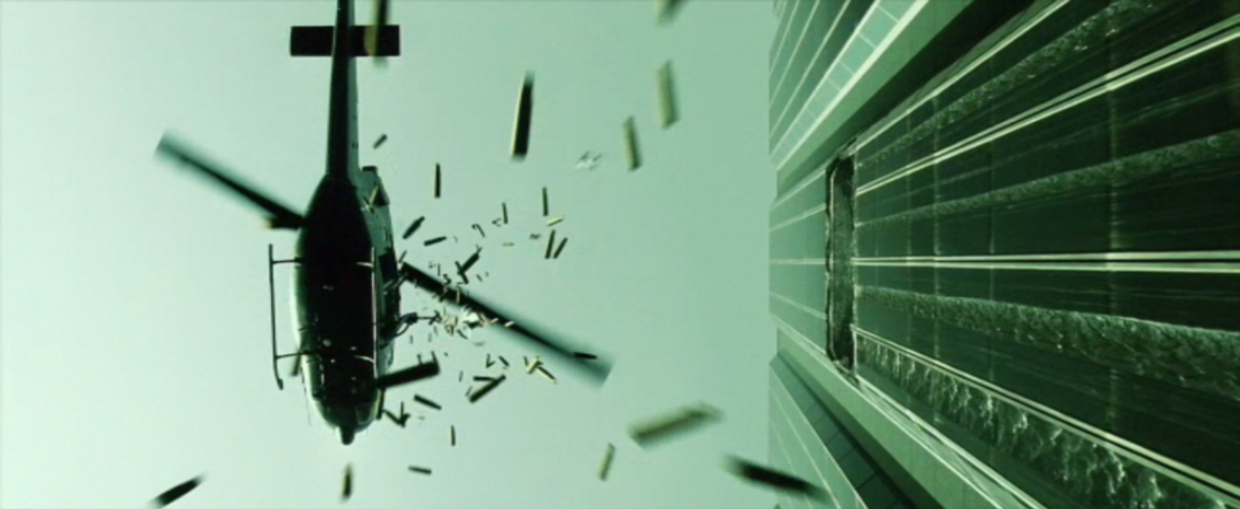
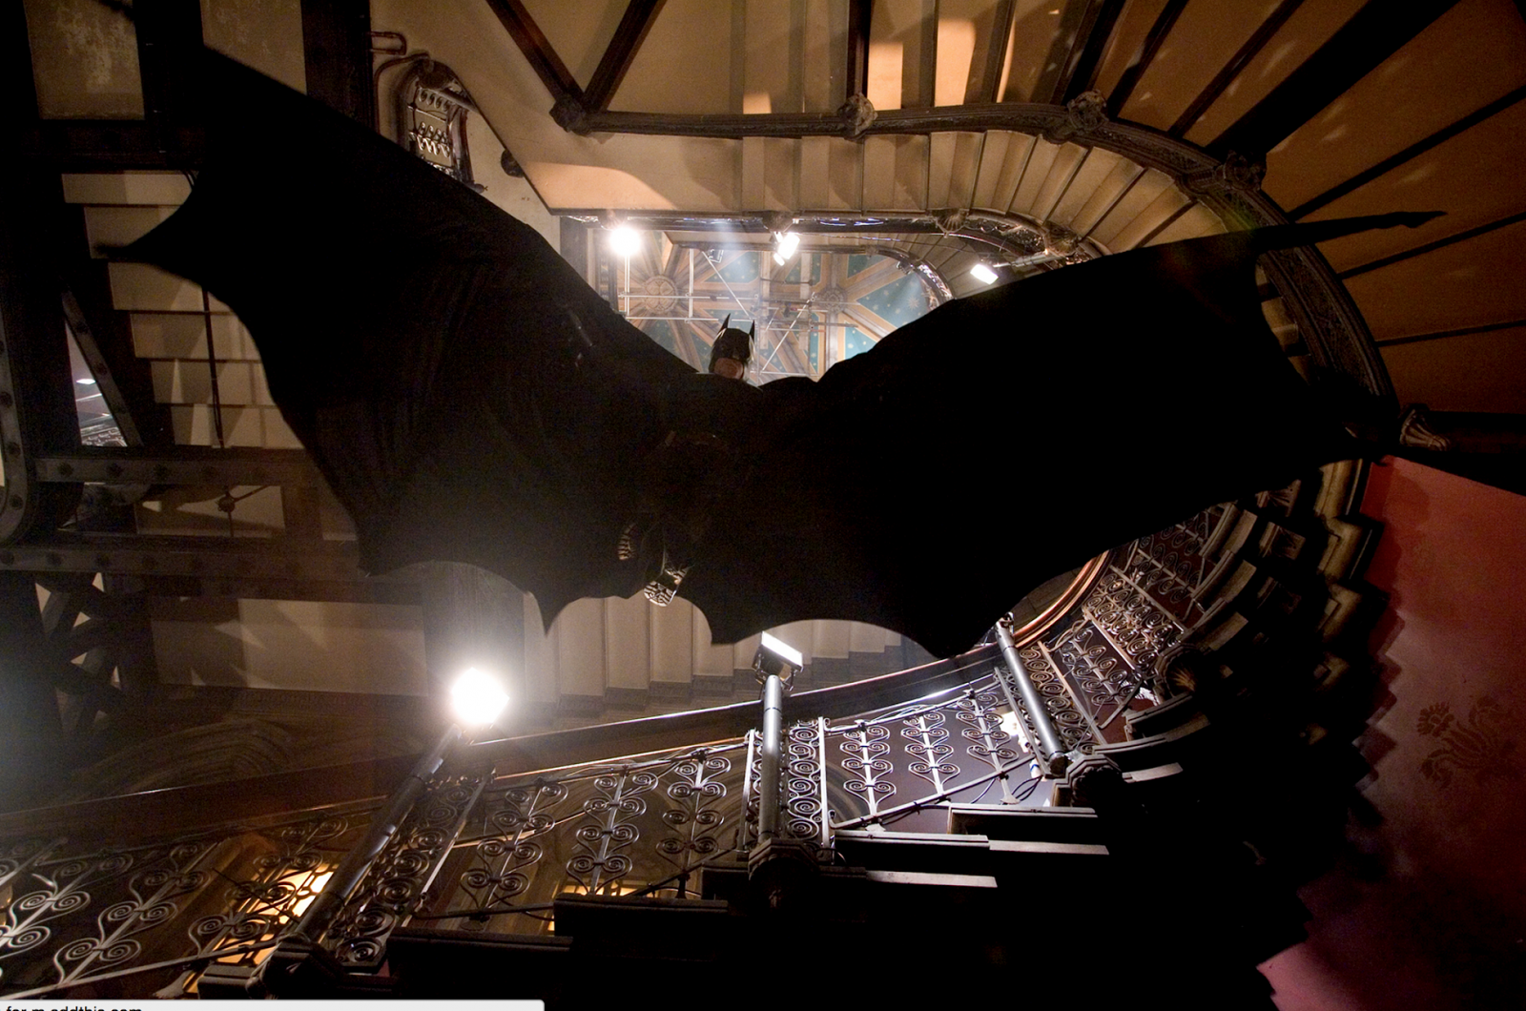
2. Camera angles
Nadir
The camera is just below the action or character.
They can be used as a subjective shot.
They are very difficult to shoot.

Slide 23
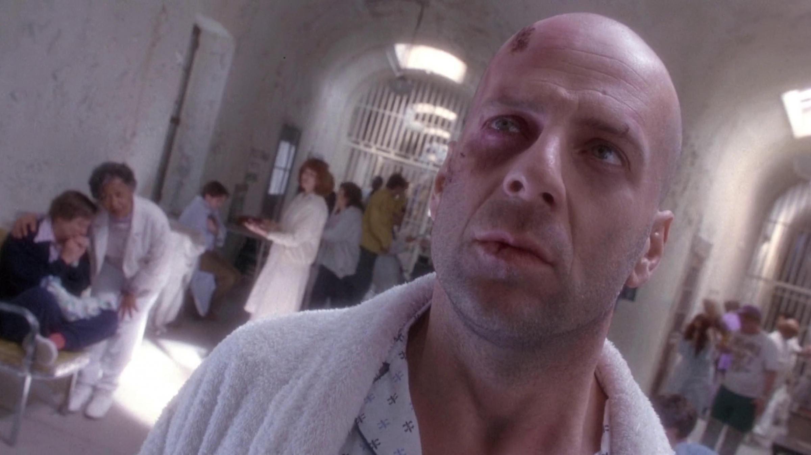
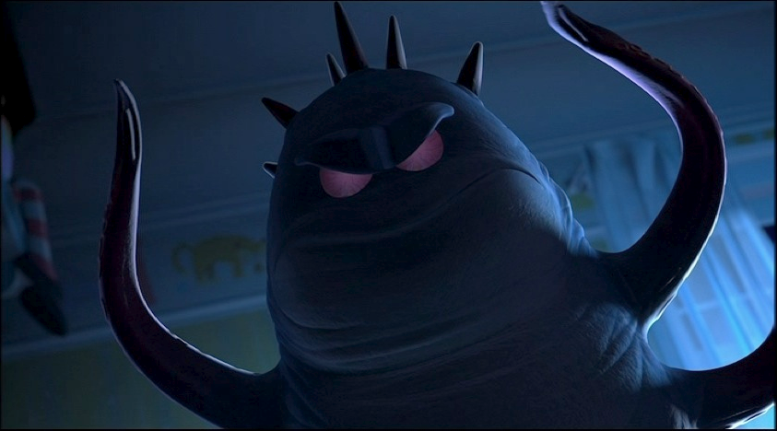
2. Camera angles
Dutch angle
They do not respect the level of the horizon
They are very shocking.
They are very useful to show abnormal attitudes or situations.

Slide 24
3. Point of view
Camera can occupy infinite positions all around the scene.
Even more, camera can replace the character position.

Slide 25
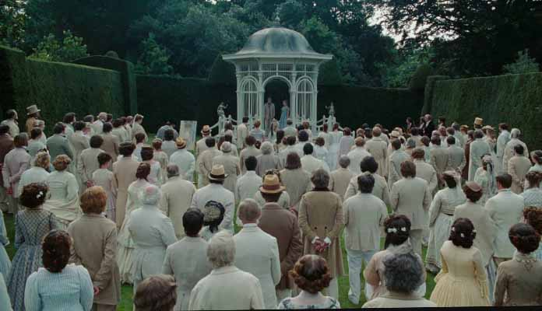
3. Point of view
Objective
The most common point of view. It shows a space from a "third man" position. The camera can be considered as a witness.
The viewer sees "though a window", but characters don´t notice the camera. They don´t interact with it.

Slide 26
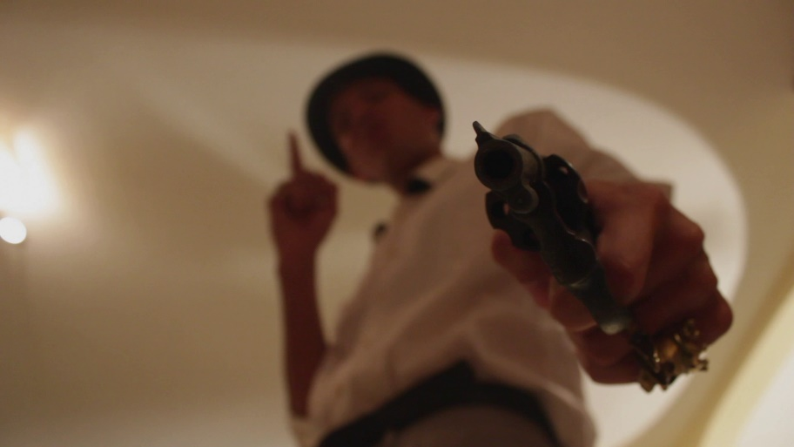
3. Point of view
Subjective
The spectator sees though the eyes of the character.
The camera occupies the place of the character, offering us exactly same vision the character has.

Slide 27
4. Continuity
There are a lot of ways to put together all the shots, but in order to create a continuous, logic and coherent story, we should put them together in a specific way.
This is called Continuity editing

Slide 28
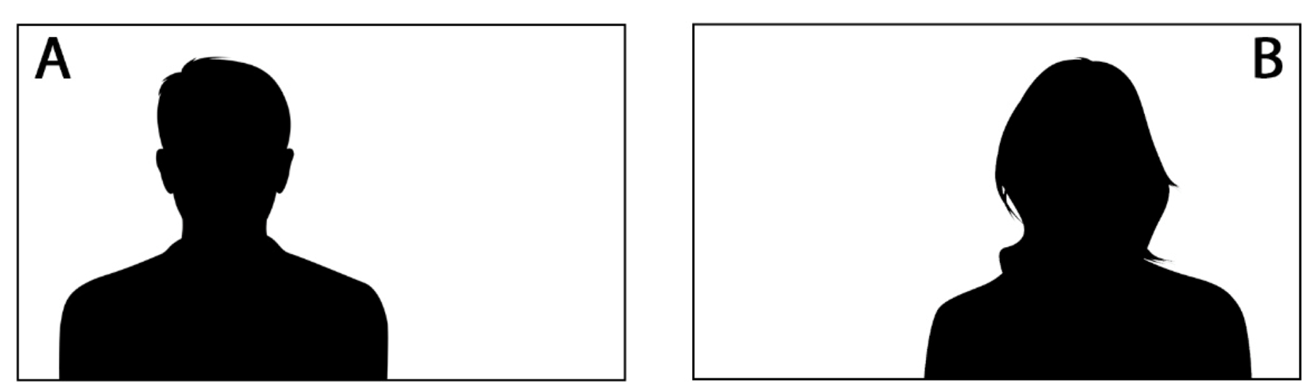
4. Continuity
Axis of sights

Slide 29
4. Continuity
Axis of sights
To keep on the continuity, both characters must look one each other.
And we have to film similar types of shots.

Slide 30
4. Continuity
Axis of movement
It is the imaginary line generated between the character and the movement it performs.
To create continuity, all shots should respect the movement and the speed.

Slide 31
5. 180-Degree rule
One of the most important rules in films.
When we shoot an action or a movement using different camera positions we must respect the axis of action. In other case, viewer will feel lost and won´t understand the direction.
AXIS OF ACTION = MOVEMENTS/SIGHTS.
  AXIS OF ACTION
  AXIS OF ACTION

Slide 32
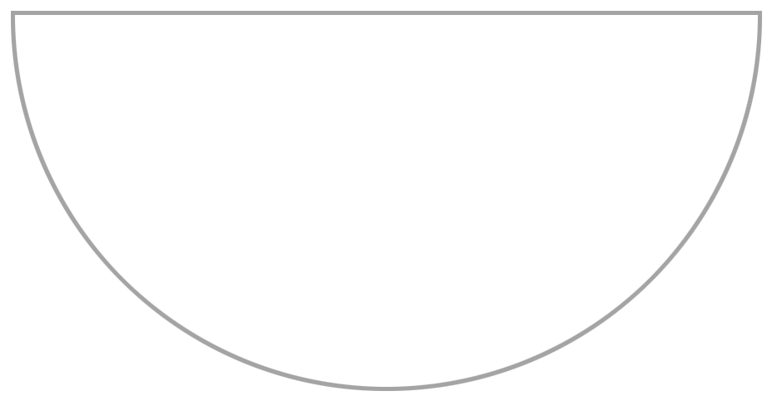
5. 180-Degree rule
180º-degree rule: In any action or movement, we will choose one of the two sides of the Axis of Action and we should always situate the camera on that side.
Therefore, all shots will respect the direction and relations between characters will be clear.
  AXIS OF ACTION
  AXIS OF ACTION

Slide 33
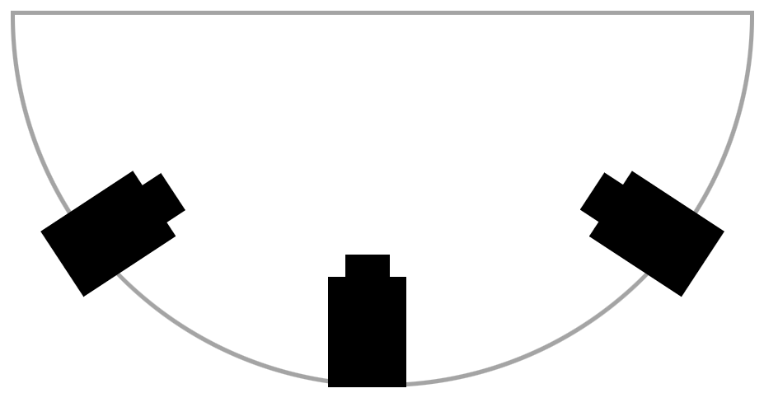
5. 180-Degree rule
This camera position invert the characters´ sight direction.
  X
  4
  1
  3
  2

Slide 34
3. 180-Degree rule
Breaking the 180-degree rule for dramatic purposes.

Slide 35

6. 30-Degree rule
-A very slightly change between shots will create discomfort in the viewer.
-At least, 30-degree change is required to justify the movement.
-If we barely move, why have we moved?
x
30º
15º

Slide 36
Activity part 1
Creating a 3/5 shots story
In groups of four or five people, create a small situation about bulliyng you can tell using between 3 or 5 shots. It has to be simple and has one, two or three characters.
Mark arrives at the school and when he sees Eric in the yard, he downs his head an walk in a rush to the main door.
During a class, Sarah discovers an anonymous note inside her book. The note says: "We have a worst world because of you".
Anna is right in front of the door of the class. She takes a very depth breath and open the door.

Slide 37
8. Planning a shooting
CREW
Filming is a group proccess where a bunch of people are involved.
Each of them has to do a specific job and assume certain responsabilities.
We can classify the different jobs in areas:
· DIRECTION ·
· CAMERA ·
· LIGHTS ·
· SOUND ·
· PRODUCTION ·
· COSTUME, MAKE UP and PROPS ·
· ACTING ·

Slide 38
8. Planning a shooting
DIRECTION
Director
  Role: Oversees the entire production, making key creative decisions and guiding the actors and crew.
  Responsibilities: Set the vision for the project, direct actors' performances, and coordinate with all departments to ensure the final product meets the desired outcome.
Assistant director
  Role: Supports the director and ensures the smooth running of the set.
  Responsibilities: Help manage the schedule, communicate with the crew, and, if necessary, deliver lines to the actors.
Script Person
  Role: Controls the continuity between shots.
  Responsabilities: Put an eye in every single element of the scene. As an example, if a character holds a phone with his left hand, Script person has to ensure the character doesn’t change the hand between takes.

Slide 39
8. Planning a shooting
CAMERA
Camera operator
  Role: Responsible for shooting and positioning cameras to capture the video footage.
  Responsibilities: Operate the camera, frame shots, and ensure the visual quality of the scenes.
Camera assistant
  Role: Supports the operator and handles the camera information document.
  Responsibilities: Help manage the shots, covers the camera info document.
Clapper
  Role: Handles the clapperboard, also known as the "slate," which is used to sync sound and video during editing.
  Responsabilities: Mark the beginning of each take by holding the clapperboard in front of the camera and snapping it shut.

Slide 40
8. Planning a shooting
LIGHTS
Light technician
Role: Ensures proper lighting for each scene.
  Responsibilities: Set up and position lights to achieve the desired look and mood of the video.
Light assistant
  Role: Supports the light technician.
  Responsibilities: Help manage lights and operate them if necessary.

Slide 41
8. Planning a shooting
SOUND
Sound technician
  Role: In charge of recording and monitoring the sound during the production.
  Responsibilities: Set up microphones, control audio levels, and ensure clear and consistent sound quality.
Sound assistant
  Role: Supports the sound technician.
  Responsibilities: Help manage sound equipment. Put microphones on actors´ clothes.

Slide 42
8. Planning a shooting
PRODUCTION
Producer (Shooting Coordinator)
  Role: Manages the overall production process, handling logistics and resources.
  Responsibilities: Coordinate between the director, crew, and location staff, ensuring that everything runs on time and within budget.
Location Coordinator (Assistant Producer)
  Role: Organizes and manages the filming locations.
  Responsibilities: Ensure the location is ready for filming, handle logistics, and troubleshoot any on-site issues.
Still image
  Role: Takes still images during the shooting, creating a visual document about the process of filming.
  Responsibilities: Create a visual book where all the scenes and all the crew rolls be present.

Slide 43
8. Planning a shooting
COSTUME, MAKE-UP AND PROPS
Costume Assistant
  Role: Assists with the selection, preparation, and fitting of costumes.
  Responsibilities: Ensure that actors are dressed in the appropriate costumes for each scene and make adjustments as needed.
Makeup Assistant
  Role: Prepares the actors' makeup to match the character’s look.
  Responsibilities: Apply and adjust makeup throughout filming to maintain consistency and enhance on-camera appearance.
Prop Assistant
  Role: Manages and organizes props used during the shoot.
  Responsibilities: Ensure that all necessary props are available, in place, and handled correctly during filming.

Slide 44
8. Planning a shooting
ACTING
Actors
  Role: Perform the characters in the production.
  Responsibilities: Deliver lines, act out scenes, and bring the script to life under the guidance of the director.
Extras
  Role: Perform non-speaking roles to enhance the realism of a scene without drawing focus from the main action.
  Responsibilities: responsible for following the director's instructions, staying in character, and maintaining continuity in the background of scenes to help create a believable setting.
Stunts
  Role: Trained professionals to depict dangerous or physically demanding scenes.
  Responsibilities: Executing complex and hazardous actions safely, following precise choreography, and ensuring the well-being of themselves and others on set during high-risk scenes.

Slide 45
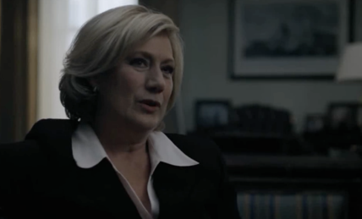
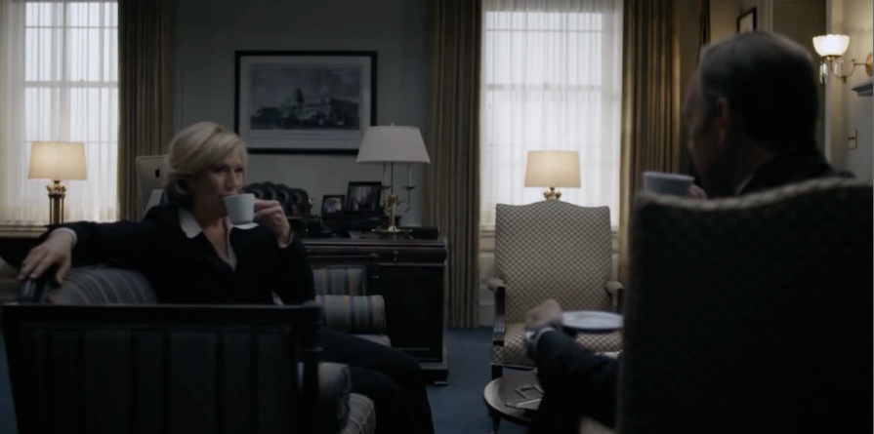
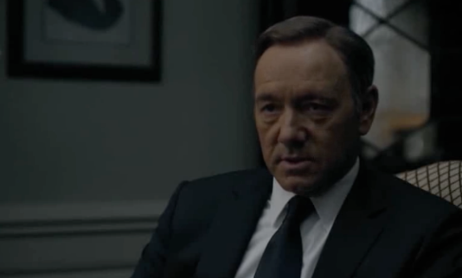
8. Planning a shooting
1 camera
Using 1 camera.
Traditional way of film.
We emulate different cameras by using only one and shooting one shot after other.
Actions, gestures, expressions, movements must be as similar as possible in all the takes.

Slide 46
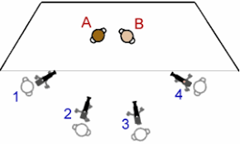
8. Planning a shooting
Multi-camera
Use of more than one camera.
Traditional way of tv shows.
Several cameras are used at the same time. Each camera must shot different angle of the action.
Requires more planification, but the shooting process can be faster.

Slide 47
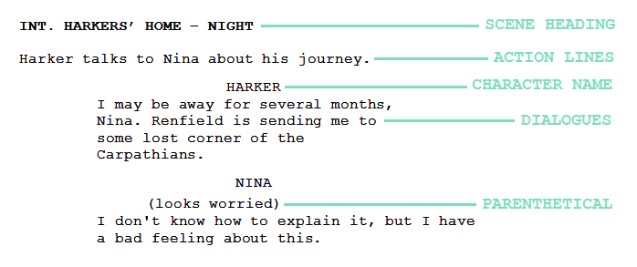
8. Planning a shooting
Narrative script

Slide 48
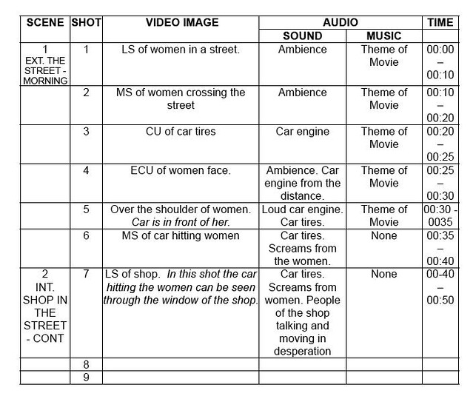
8. Planning a shooting
Technical script
A list of all the shots that must be filmed.
It has to show: Scene, Shot number, Shot type, description of the action, sound (voice, music, fx…), time and total time.

Slide 49
8. Planning a shooting
Floor plan
Physical space is drown from a zenithal position.
Very useful to situate characters, cameras, and axis of action.
1
2

Slide 50
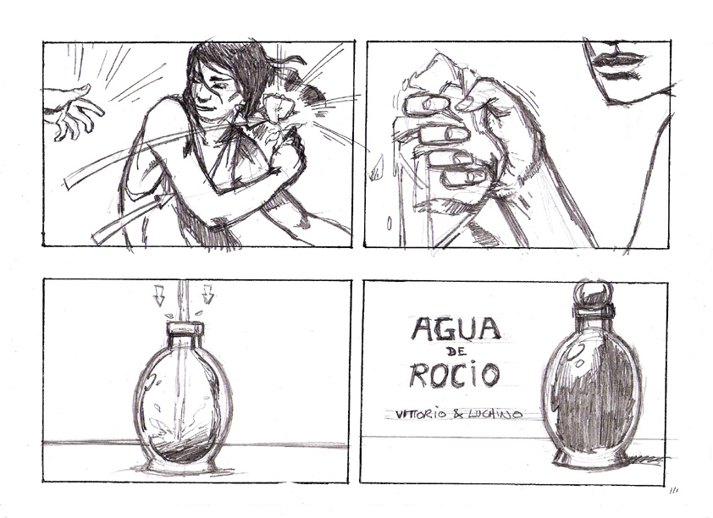
8. Planning a shooting
Storyboard
Very simple scratch of every shot.
Very useful to clarify positions and continuity between shots.

Slide 51
Activity part 2
Creating a 3/5 shots story
In groups, you must complete both the technical script and the storyboard of your story

Slide 52
8. Planning a shooting
Camera info
Record the shots and takes made.
It must include: archive name, shot number, take number, take value (good, bad, reserve) and any other important observation.
Archive name | Secuence Number | Shot Number | Take Number | Good | Bad | Reserve | Observations

Slide 53
8. Planning a shooting
Camera configuration
Using a mobile device: take an orientation (horizontal or vertical) and respect it along the shooting.
If it is possible, use 4K resolution. This will allow you to resize the images in case you need it.
Decide which frame rate (fps) you will use and respect it along the process. Our recommendation is 30fps.

Slide 54
8. Planning a shooting
Sound configuration
For closest shots, where camera mic is near to the sound, mobile mic could be fine if you are in a quiet space.
For wide shots and noisy spaces, you will need creativity:
  Hide another mobile in the scene, closer to the voices and use its sounds.
  This process makes more complex the shooting and requires to synchronize the two cameras. This could be made by clap technique.

Slide 55
8. Planning a shooting
Advices
Everybody must have a mission.
At the beginning and the end of every take, at least 3 seconds are mandatory. They must be in silence and the actors must keep in their characters.
Before every take, this mantra must be repeated: “Silence… Recording… 5 and action…”
Notes:
Now, lets shoot each story.

Slide 56
Activity part 3
Creating a 3/5 shots story
Record the shots of your story, covering the camera info document.

Slide 57
How can we manage a film shooting?
Tips and advices to understand and organize it.

Slide 58
Pablo Fernández Pena
Audiovisual technician - CUFIE
PTXAS UDC
Manuel García Torre
PhD, Lecturer
Coordinator of the E-Learning Unit (CUFIE)
Department of Sociology and Communication Sciences
Faculty of Communication Sciences, University of A Coruña

